Slide 1
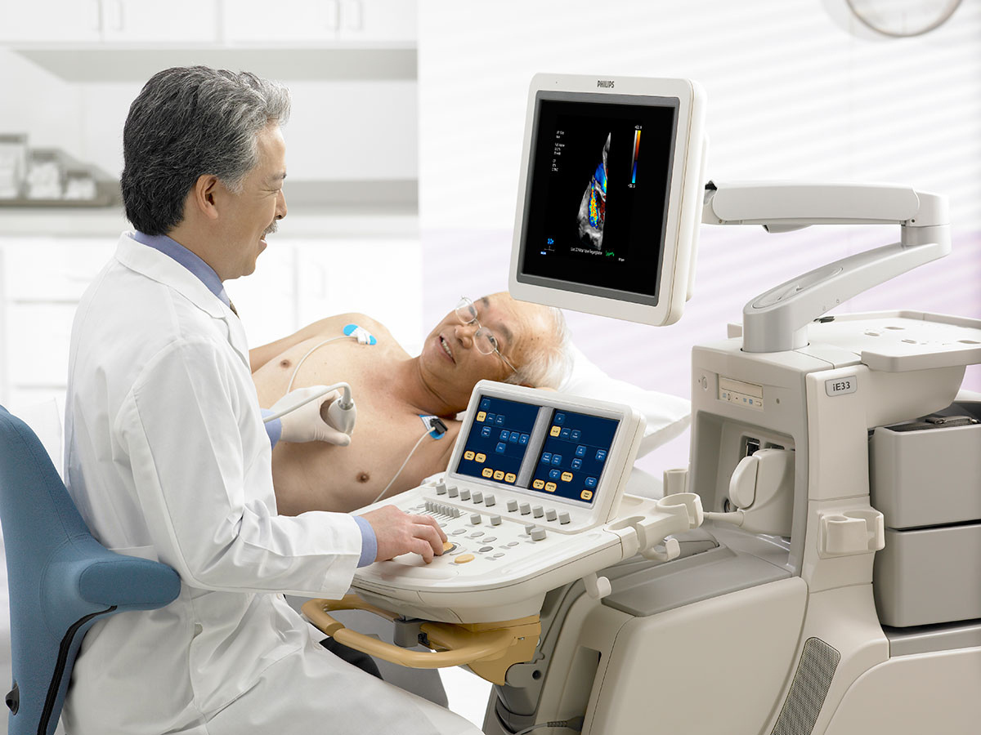


End-to-End Echocardiographic Analysis Pipeline
AI-powered assessment and reporting of the heart function
Team 12
Under the supervision of:
Prof. Ahmed Fahmy
Prof. Tamer Basha
1

Slide 2


Agenda
1.
2.
Problem Definition
Literature Review
3.
4.
Models Development
Web Development
5.
Tools
6.
What Is Next ?

Slide 3
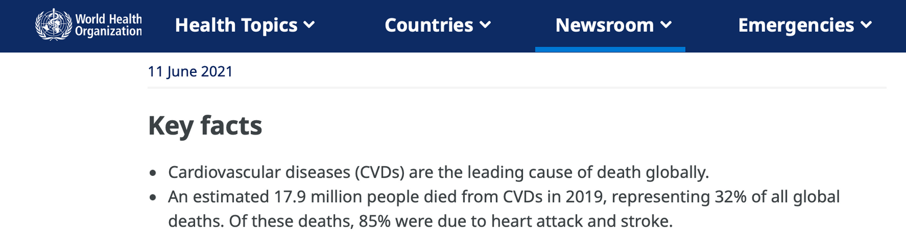
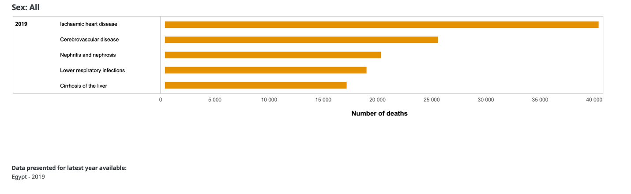

Cardiovascular diseases (CVDs) are the leading cause of death globally!
3

Slide 4
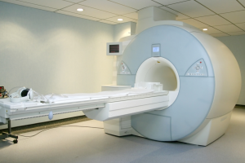
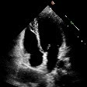

Why Is Echocardiography Critical ?
01
Non-Invasive ultrasound
02
Cost and Accessibility
03
Real-Time Visualization
4
Sanjeevi G., Uma Gopalakrishnan, Rahul Krishnan Parthinarupothi, Thushara Madathil,
Deep learning supported echocardiogram analysis: A comprehensive review, Artificial Intelligence in Medicine,Volume 151,2024

Slide 5
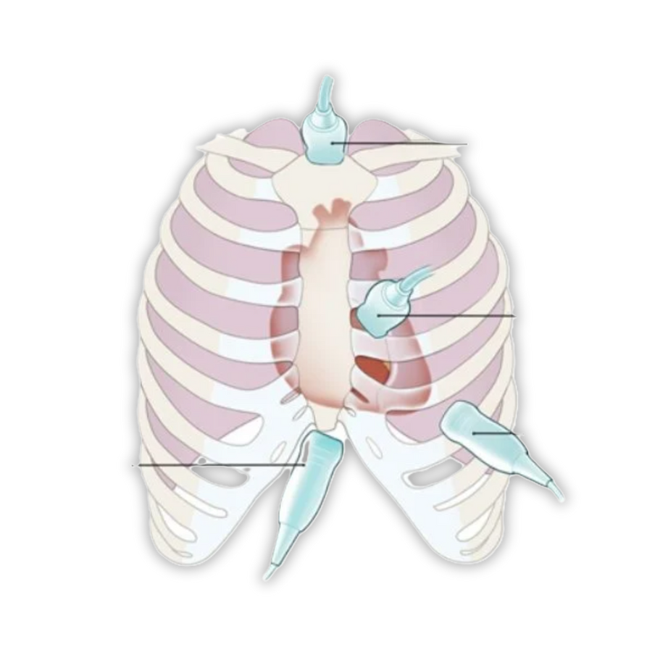
Echocardiography Challenge
Echocardiography uses multiple imaging windows to capture the heart’s complex 3D anatomy.
Each window captures one or more views.
Suprasternal
Parasternal
Apical
Subcostal
5

Slide 6
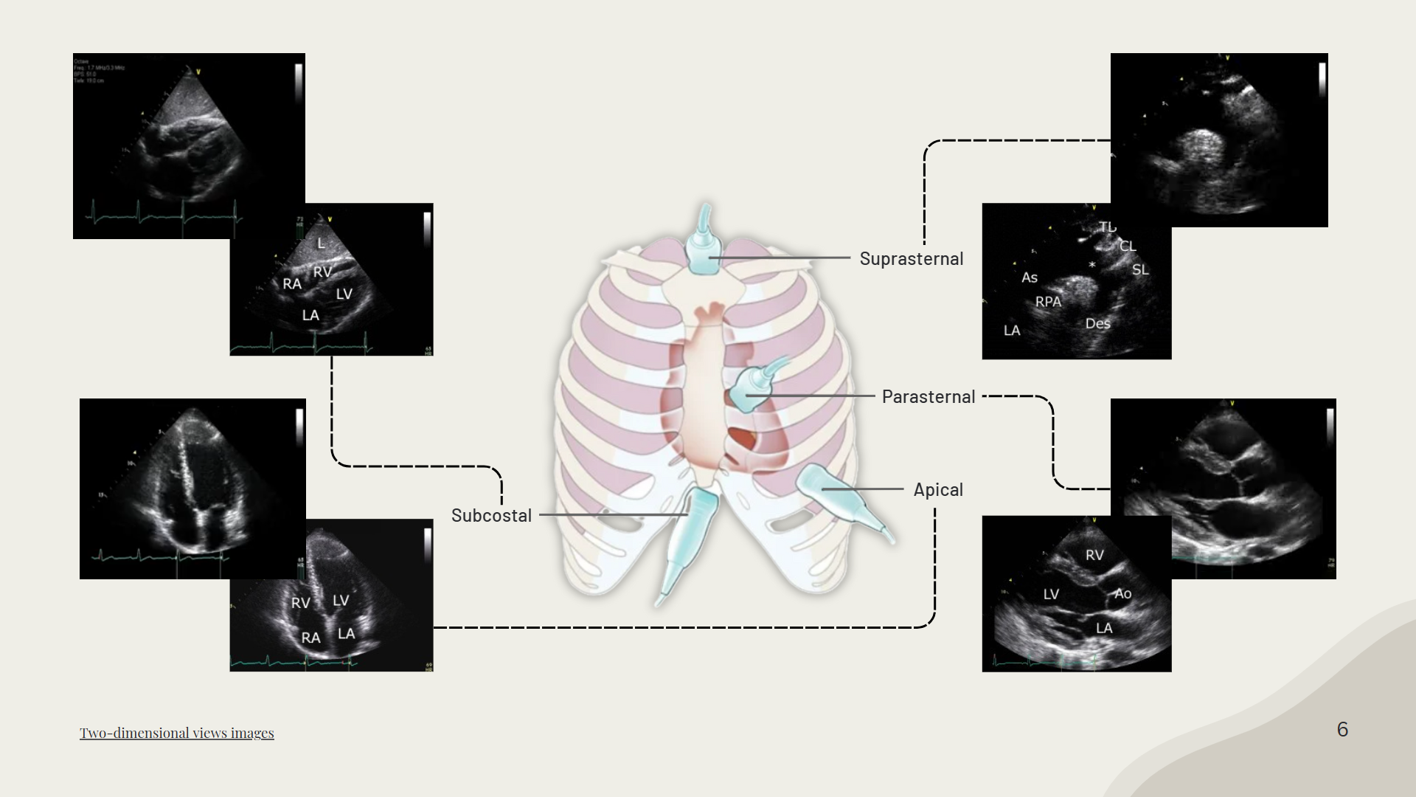

Slide 7

AI Enhancements for Echo Workflow
Challenges
AI as a Solution
Time-consuming process that increases the workload.*
Enhance clinical workflow.
Automate traditional tasks.
Reduce clinician workload.
The clinician’s expertise plays a crucial role in echocardiogram analysis.*
7
*Sanjeevi G., Uma Gopalakrishnan, Rahul Krishnan Parthinarupothi, Thushara Madathil,
Deep learning supported echocardiogram analysis: A comprehensive review, Artificial Intelligence in Medicine,Volume 151,2024

Slide 8










Existing AI Echocardiography Products
iCardio.ai
$2–$4 per scan
InstaEcho
$2.5–$6 per scan
US2.AI
ViewPoint 6
HeartLab Pulse
AISAP's CARDIO
8

Slide 9
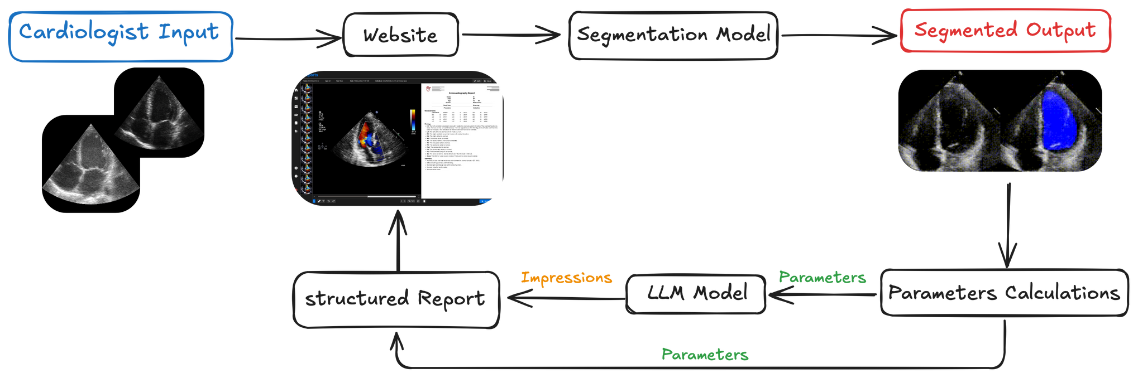
End-to-End Echocardiographic Analysis and Reporting Pipeline
9

Slide 10

Project Phases Overview
Literature Review and Datasets
Models
Development
Web
Development
10

Slide 11
Literature Review and Datasets
11

Slide 12
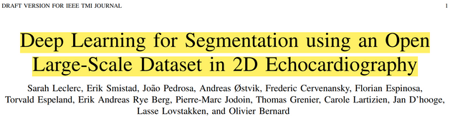

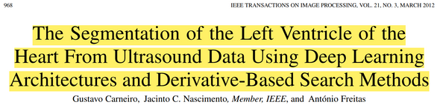


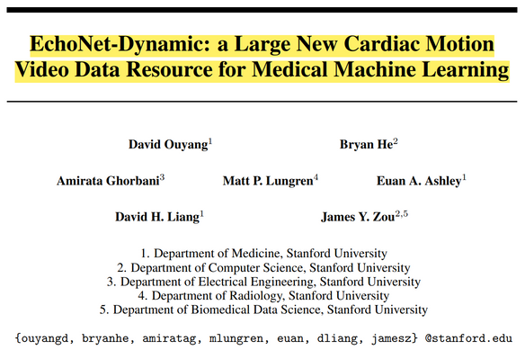


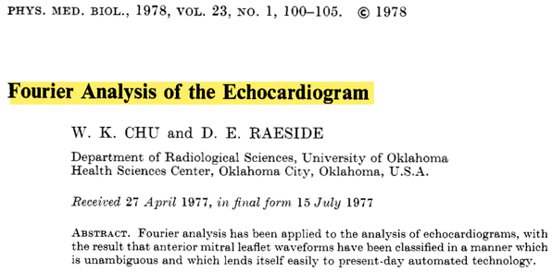
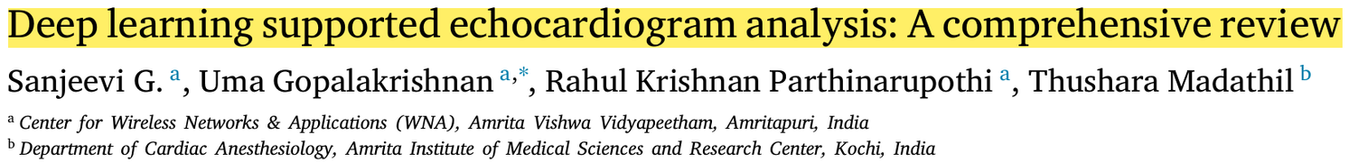

History of Automation of
Echocardiography Analysis
1978
2014
Present
Early Application of Deep Learning
CAMUS & EchoNet-Dynamic Datasets
Early Integration of Machine Learning
CETUS Challenge
Open Challenges
2012
2019
12

Slide 13


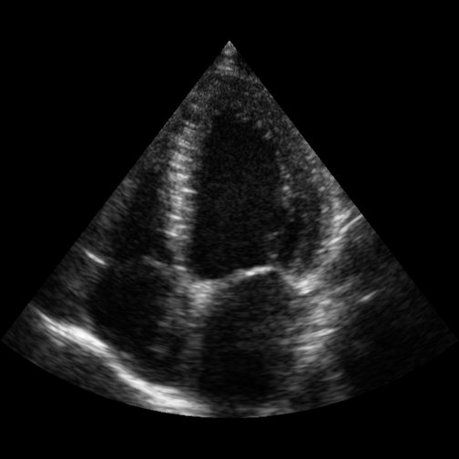
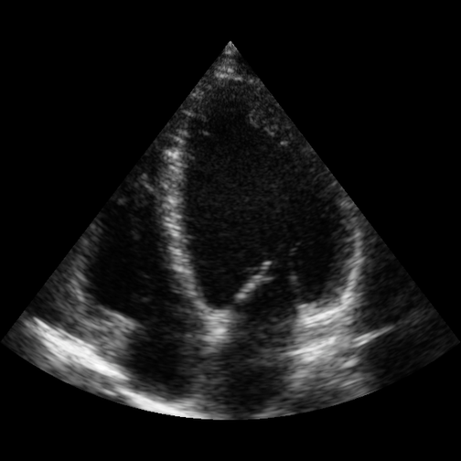
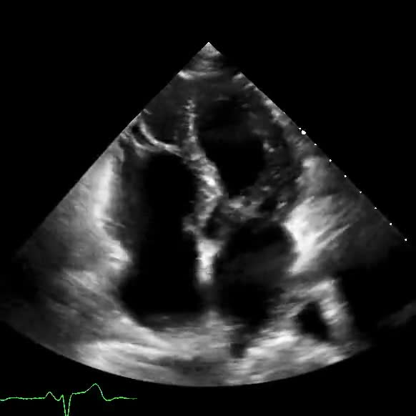
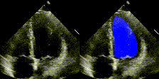
CAMUS & EchoNet-Dynamic
Datasets
2019
CAMUS
EchoNet Dynamic
End Diastole
End Systole
Apical 2- and 4-chamber view 2D sequences from 500 patients
Apical 4-chamber 2D grey-scale videos from 10,036 individuals
13

Slide 14
History of Automation of
Echocardiography Analysis
1978
2014
Present
Early Application of Deep Learning
CAMUS & EchoNet-Dynamic Datasets
Early Integration of Machine Learning
CETUS Challenge
Open Challenges
2012
2019
12

Slide 15
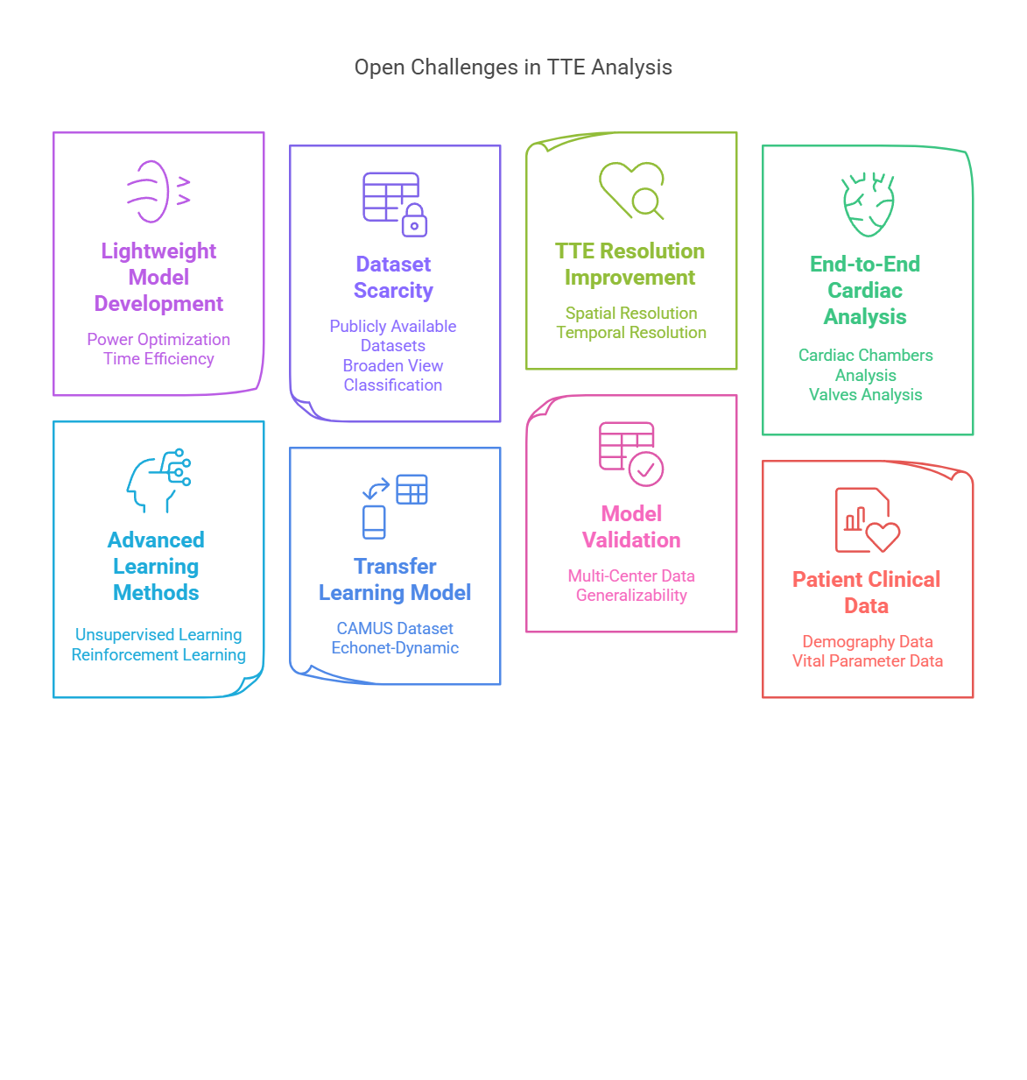
Present
15
Infographic generated by Napkin

Slide 16
Project Phases Overview
Literature Review and Datasets
Models
Development
Web
Development
16

Slide 17

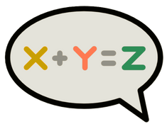

Models
Development
Segmentation
Parameters
Calculation
Reports
Generation
17

Slide 18
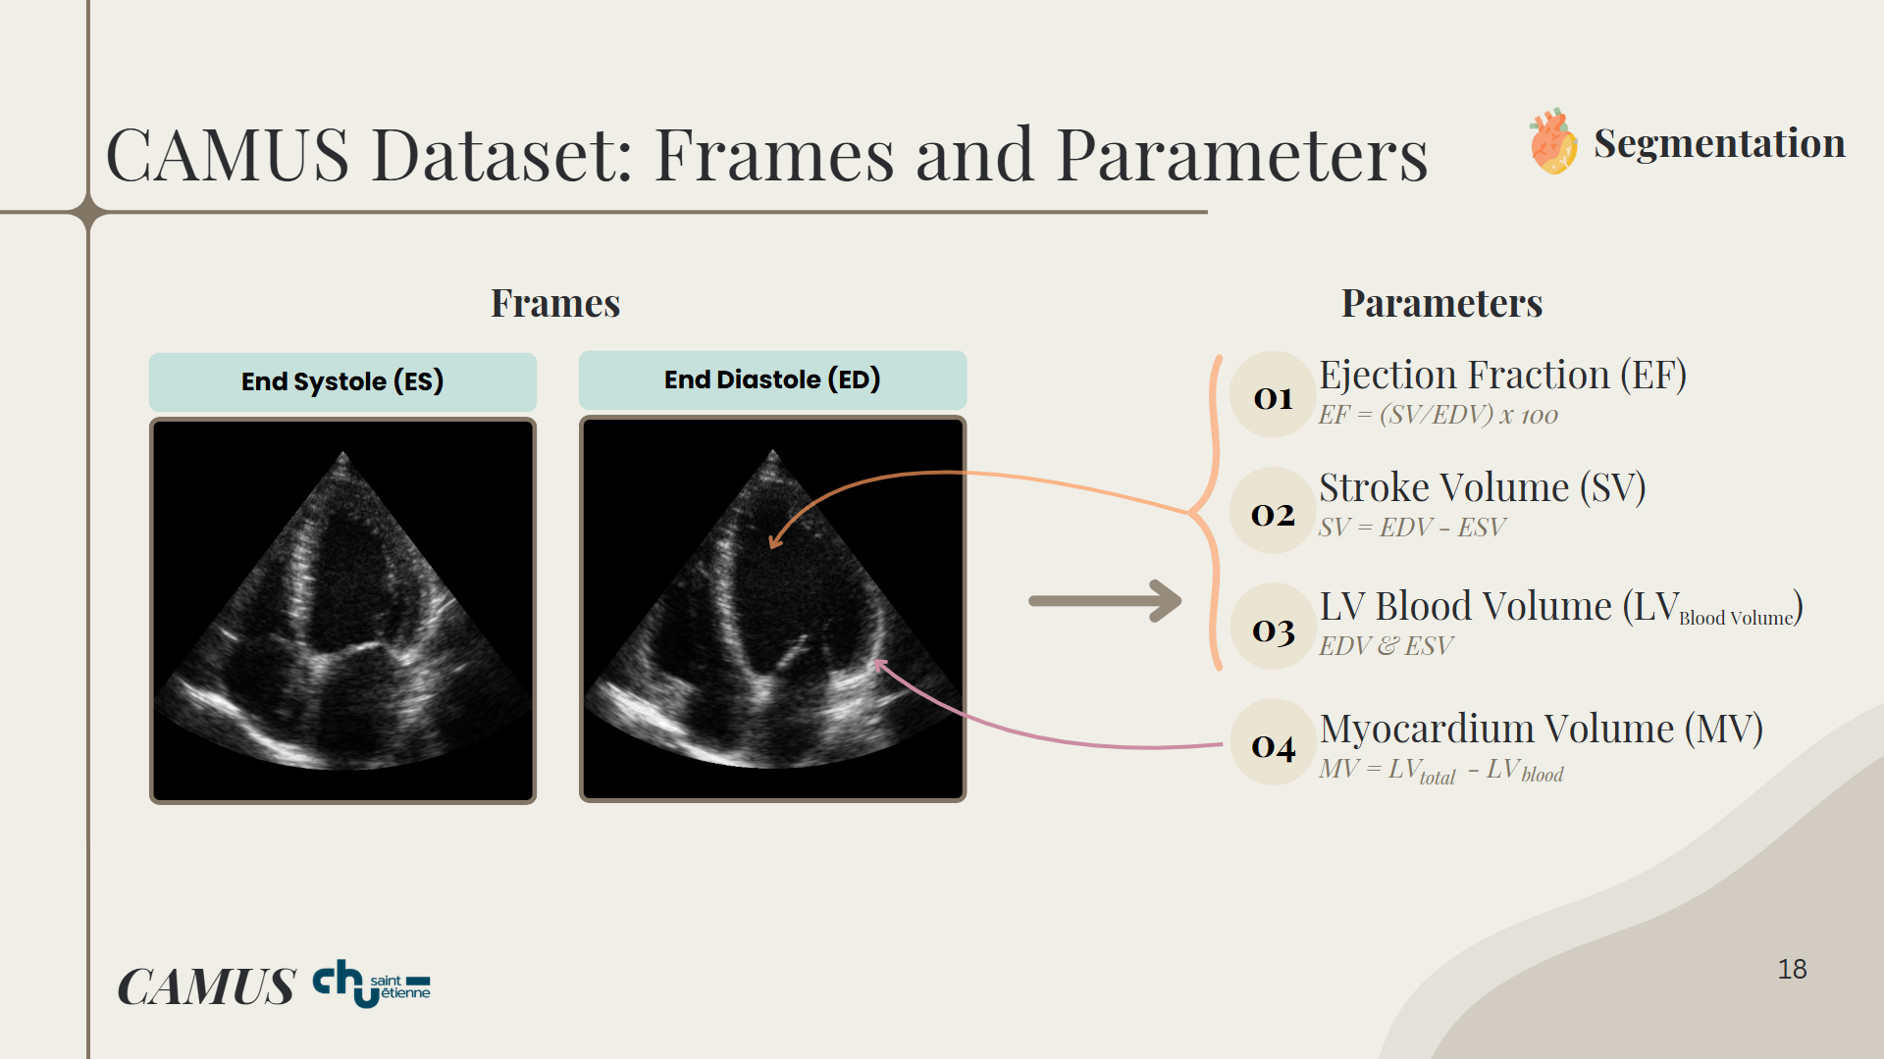

CAMUS Dataset: Frames and Parameters
Segmentation
Frames
Parameters
End Systole (ES)
End Diastole (ED)
Ejection Fraction (EF)
01
EF = (SV/EDV) x 100
02
Stroke Volume (SV)
SV = EDV - ESV
03
LV Blood Volume (LV )
Blood Volume
EDV & ESV
04
Myocardium Volume (MV)
MV = LV - LV
total
blood
CAMUS
18

Slide 19

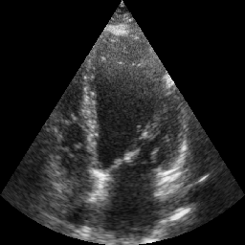
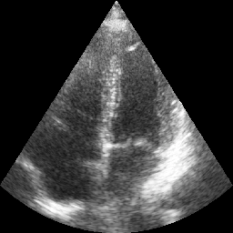
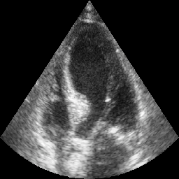
CAMUS Dataset: Preprocessing
Segmentation
Raw Images
CAMUS
19

Slide 20

CAMUS Dataset: Preprocessing
Segmentation
Raw Images
Output Images
Resizing
256 X 256
CAMUS
20

Slide 21
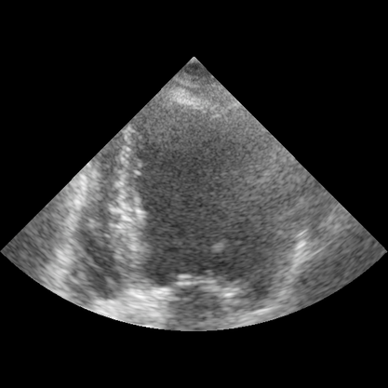
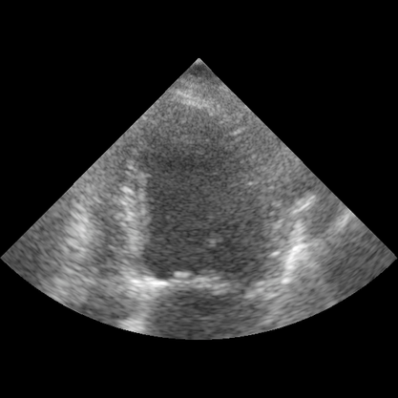
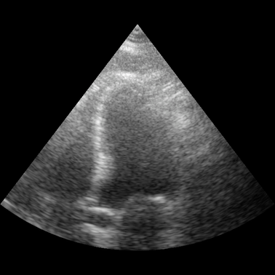
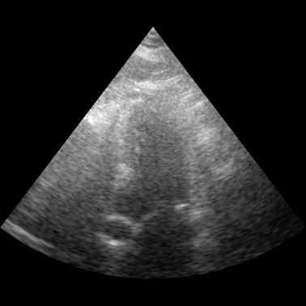


Segmentation
Segmentation
Image Quality Distribution
End Diastole (ED)
End Systole (ES)
n = 94
9.4%
Poor
n = 330
33%
Medium
n = 576
57.6%
Good
21

Slide 22
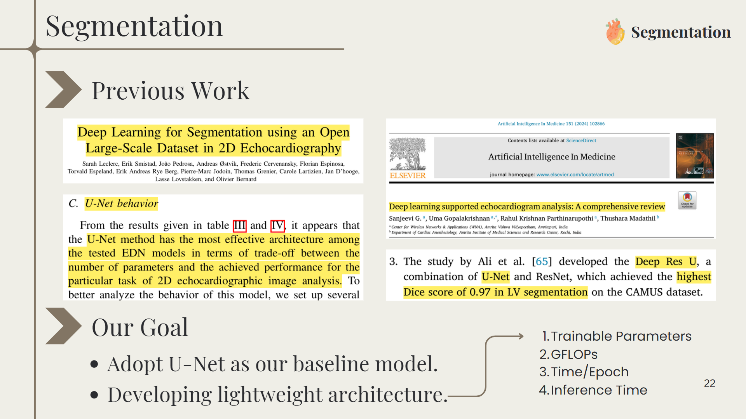
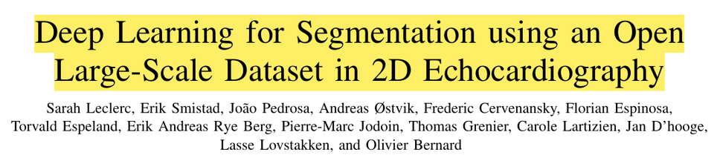
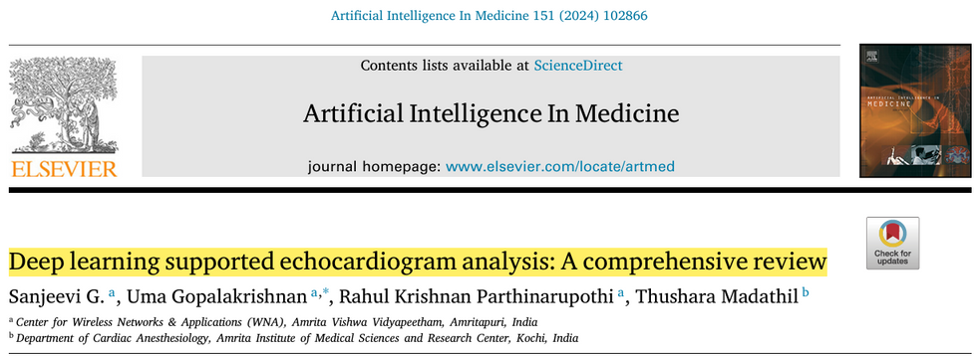
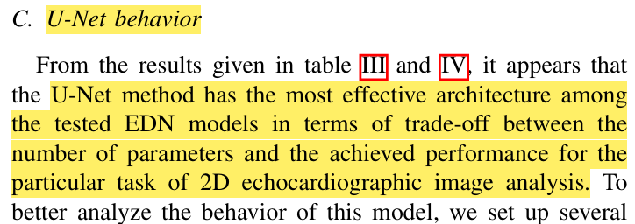
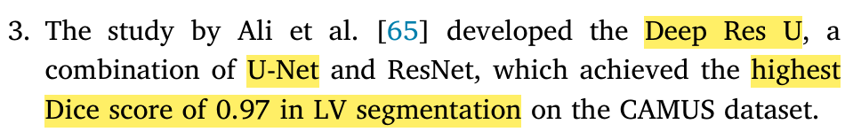
Segmentation
Segmentation
Previous Work
Our Goal
Trainable Parameters
GFLOPs
Time/Epoch
Inference Time
Adopt U-Net as our baseline model.
Developing lightweight architecture.
22

Slide 23
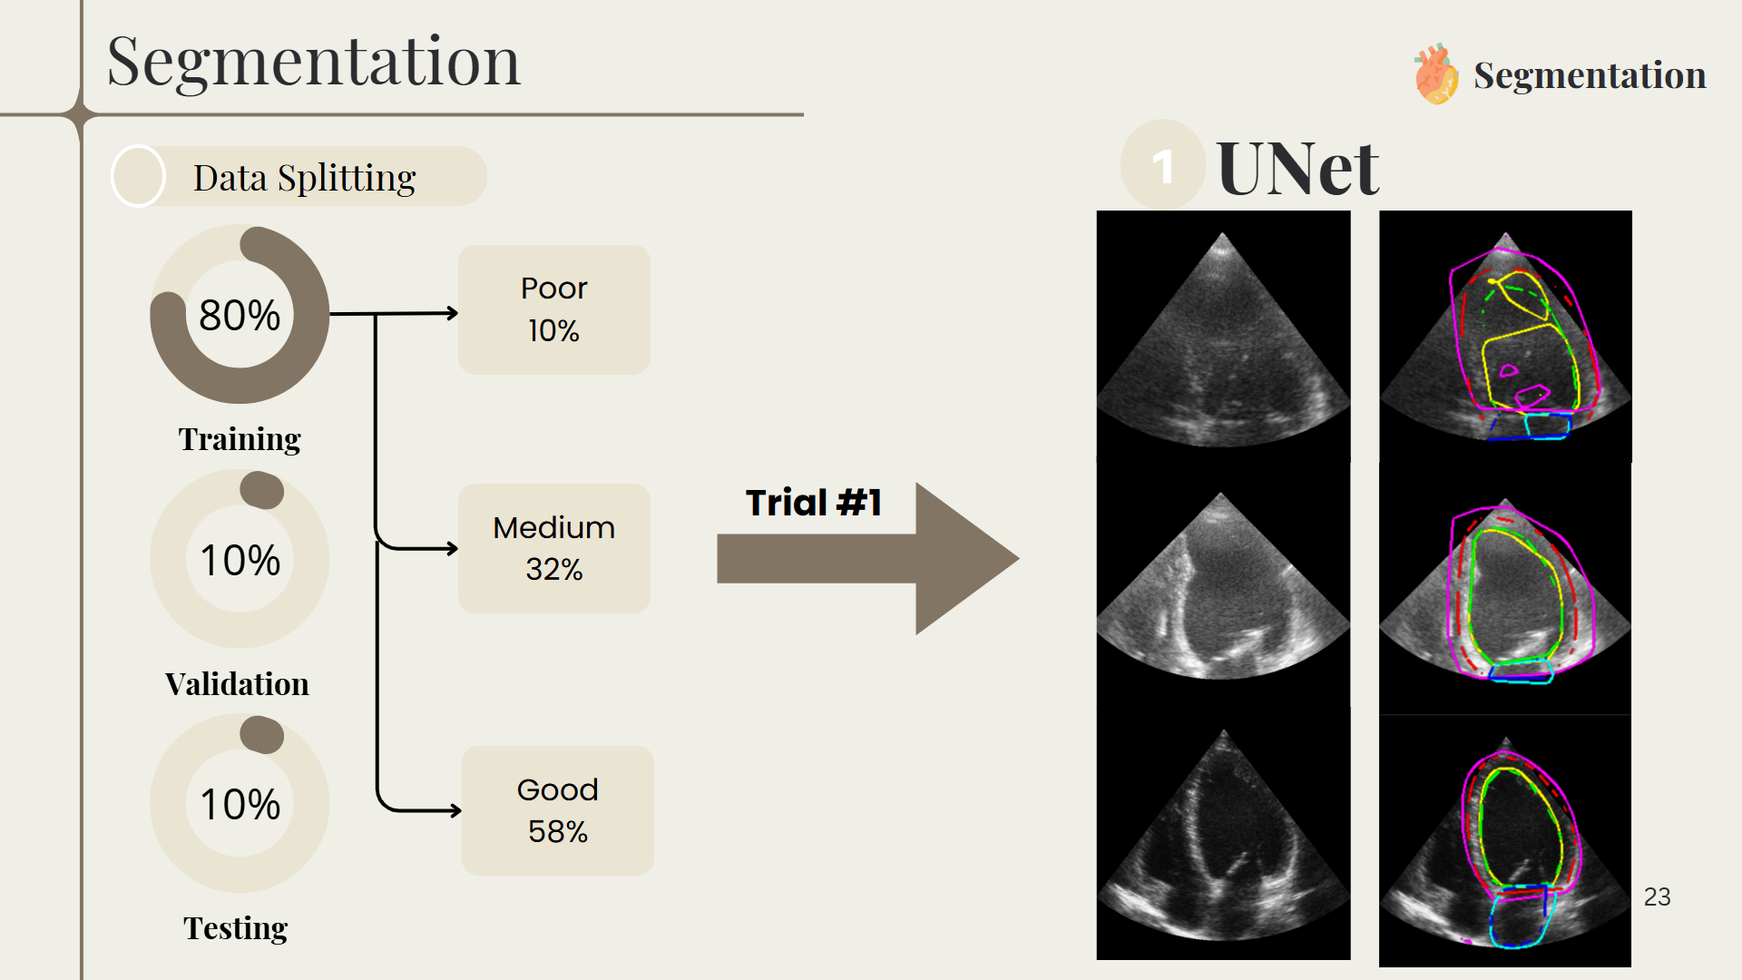

Slide 24
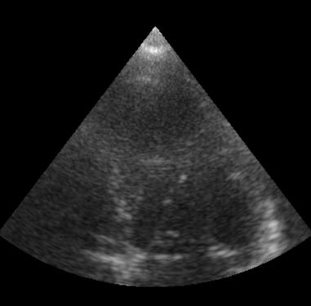
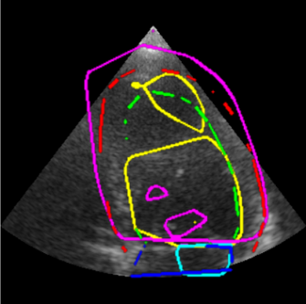
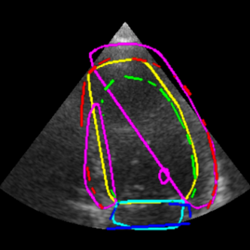
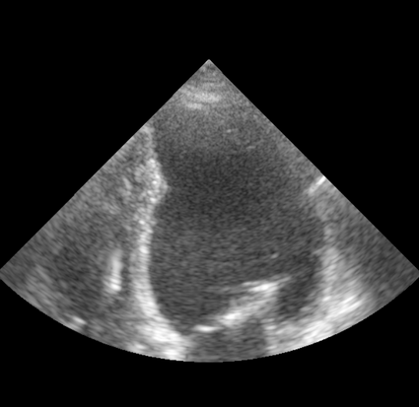
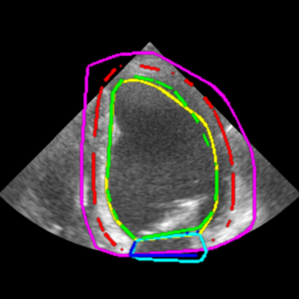
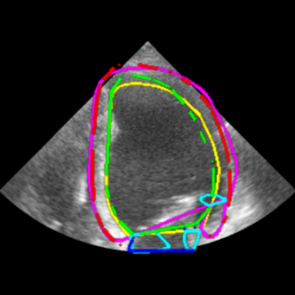
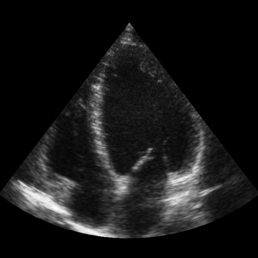
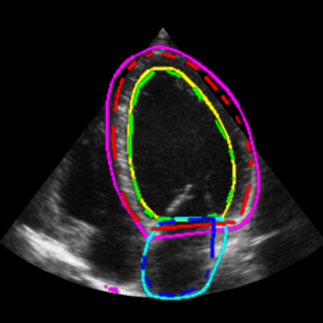
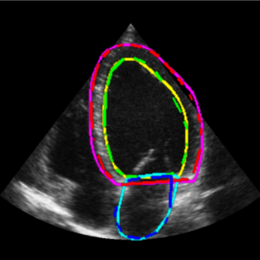
Segmentation
Segmentation
1
UNet
Lightweight UNet
Hyperparameter Tuning
24

Slide 25
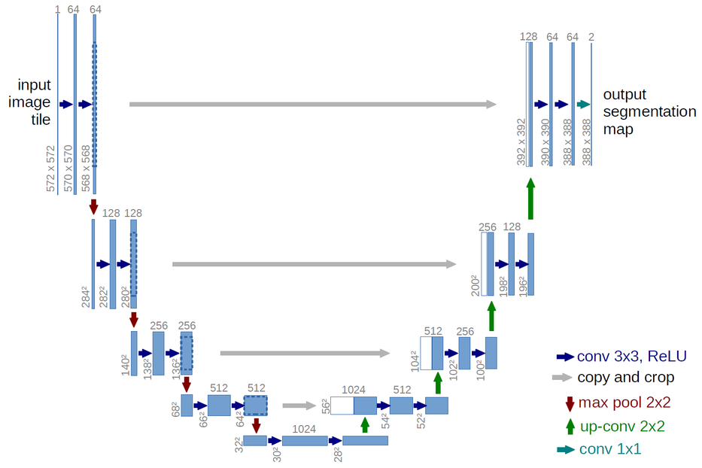
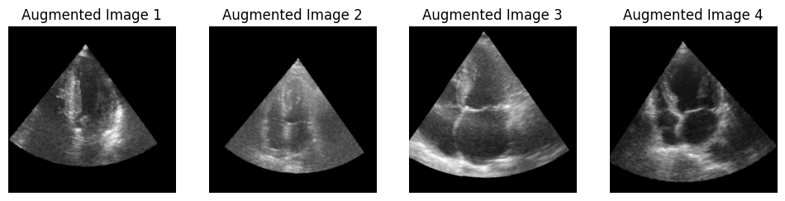
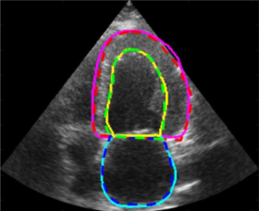

Segmentation
Segmentation
2
Pretrained UNet
Backbone
Training Data
Output
Data Augmentation
Num of Classes = 3
convnext_base Backbone
Hyperparameter Tuning
25

Slide 26

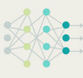



Segmentation
Segmentation
1
2
Lightweight UNet
Pretrained UNet
Trainable Parameters
1.9M
93M
GFLOPs
21.4
47.24
Training
Speed
18.86 sec/epoch
38.32 sec/epoch
Inference
Time
ED: 6.72 ms/img
ES: 6.70 ms/img
ED: 21.14 ms/img
ES: 19.80 ms/img
26

Slide 27
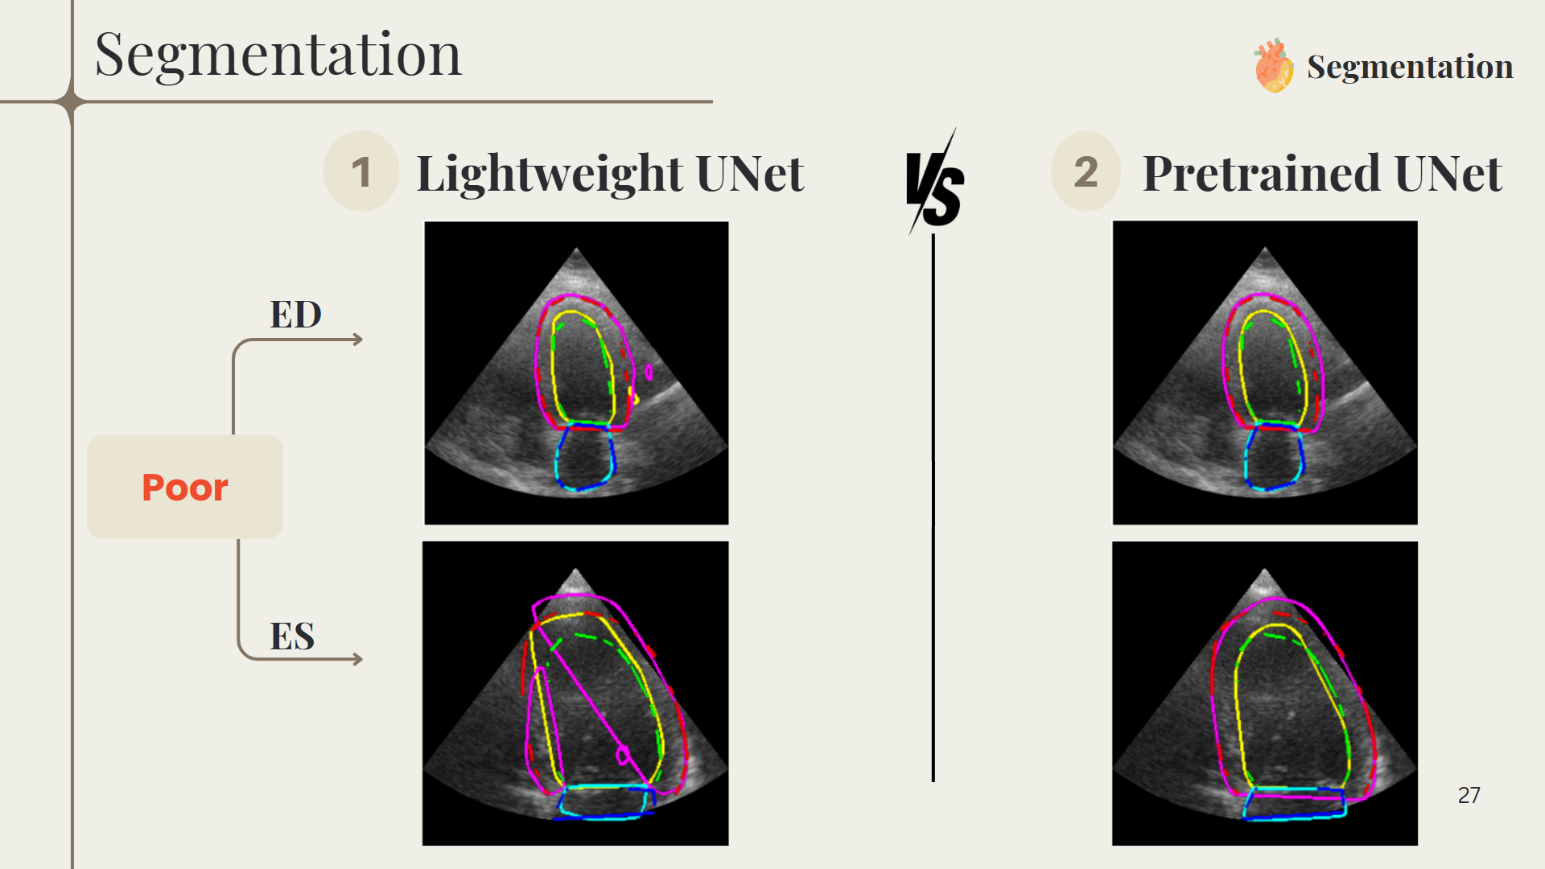
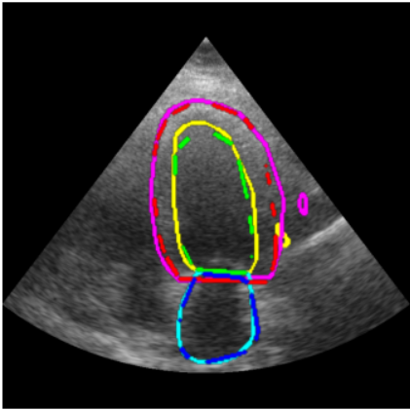
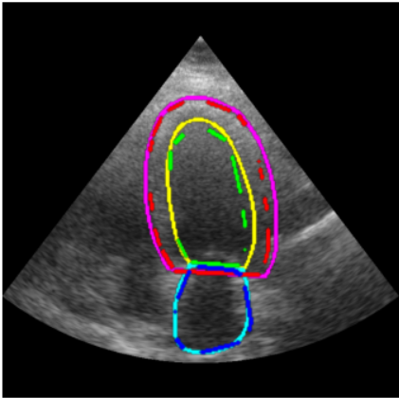
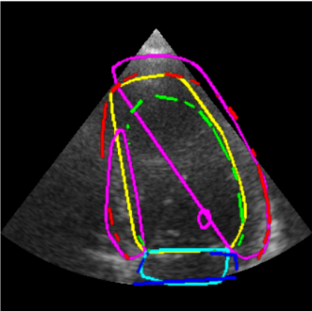

Segmentation
Segmentation
1
2
Lightweight UNet
Pretrained UNet
ED
Poor
ES
27

Slide 28


Slide 29


Slide 30





Supervised Vs Self-Supervised
Segmentation
Input Raw Data
Annotations
Model
Prediction
30

Slide 31




Supervised Vs Self-Supervised
Segmentation
Input Raw Data
Zero-Shot Learning
Manual Annotation !
Annotations
Model
Prediction
31

Slide 32


Zero-Shot Segmentation
Segmentation
3
SAM &MedSAM
Testing Data
Output
Num of Classes = 1
Bounding Box & Point
32

Slide 33








Zero-Shot Segmentation
Segmentation
Impact of Prompt Types on Segmentation Accuracy
01
Interactive Box Prompt
SAM
Dice Score : 0.79
Dice Score : 0.89
Even for the same image, results depend on user selection.
MedSAM
Dice Score : 0.63
Dice Score : 0.95
33

Slide 34








More Examples
Segmentation
MedSAM
MedSAM
34

Slide 35







Zero-Shot Segmentation
Segmentation
Impact of Prompt Types on Segmentation Accuracy
02
Single Point Prompt
SAM
Dice Score : 0.88
Dice Score : 0.89
MedSAM
Dice Score : 0.96
Dice Score : 0.94
35

Slide 36

Segmentation
Segmentation Challenges
36

Slide 37










Batch Testing on Dataset
Segmentation
Overall Performance on the test dataset
01
Randomized Box Sampling
Dice Score : 0.88
Dice Score : 0.85
Dice Score : 0.52
(-20, 20)
(-30, 30)
Dice Score : 0.60
Standard Deviation: 0.15
(-10, 10)
(-50, 50)
37

Slide 38






Batch Testing on Dataset
Segmentation
Impact of Prompt Types on Segmentation Accuracy
02
Randomized Point Prompt
Dice Score : 0.94
Dice Score : 0.86
Dice Score : 0.49
Dice Score : 0.71
Standard Deviation: 0.19
38

Slide 39



Fine-Tuning SAM
Segmentation
The goal is not necessarily to increase performance but to achieve comparable or close results to a specialized U-Net using a small number of labeled images (e.g., 100)
39

Slide 40
Segmentation
Segmentation
1
Fine-tuning SAM
2
Pretrained UNet
Training Images
100 images
800 Images
EPOCHS
10
150
Training
Time
8 min
97 min
Inference
Time
460 ms/Img
20 ms/Img
40

Slide 41





Segmentation
Segmentation
1
Fine-tuning SAM
2
Pretrained UNet
DCI
0.86
0.95
41

Slide 42
Generalisation Test 1
Segmentation
To assess how a large foundation model like MedSAM performs relative to our specialized U-Net.
U-Net
MedSAM / SAM
 | Pretrained UNet | SAM box | SAM point | MedSAM box | MedSAM point | Fine-tuned SAM
Dice Score | 0.93 | 0.59 | 0.71 | 0.67 | 0.80 | 0.86
42

Slide 43







EchoNet Dynamic Preparation
Segmentation
Frames Extraction
Extract frames from .avi videos
Two Frames
in the CSV file
Automatic Frame Selection?
43

Slide 44

EchoNet Dynamic Preparation
Segmentation
Creating Masks
Masks
44

Slide 45


EchoNet Dynamic Preparation
Segmentation
Creating Masks
45

Slide 46




EchoNet Dynamic Preparation
Segmentation
Creating Masks
CAMUS
46

Slide 47



EchoNet Dynamic Preparation
Segmentation
Creating Masks
Convert to filled polygons
47

Slide 48
EchoNet Dynamic Preparation
Segmentation
Testing
Backbone
convnext_base Backbone
48

Slide 49


Slide 50
EchoNet Dynamic Preparation
Segmentation
Testing
Backbone
LV (1)
Myocardium (2)
LA (3)
Background (0)
LV (1)
Background (0)
convnext_base Backbone
50

Slide 51
EchoNet Dynamic Preparation
Segmentation
Testing
Backbone
Class | Dice | IoU | ASSD | Hausdorff | F1 Score
Background | 0.981 | 0.964 | 1.58 | 7.3 | 0.981
LV | 0.837 | 0.737 | 7.58 | 19.3 | 0.837
convnext_base Backbone
51

Slide 52
Models
Development
Segmentation
Parameters
Calculation
Reports
Generation
52

Slide 53


Parameters Calculations
Parameters
Calculation
Echocardiographic Methods for LVEF Calculation
53

Slide 54
Sample Patients Results
Parameters
Calculation
Patient_ID | Calculated_EF | Ground_Truth_EF
224 | 31 | 38
260 | 55 | 52
EDV_ml | ESV_ml | SV_ml | BV_ml
112 | 75 | 37 | 112
84 | 37 | 46 | 84
Mean EF Difference: 6.9% ± 4.6%
Patients with acceptable EF (within ±10.0%): 40/50 (80.0%)
Mean GT EF difference: 5.84 ± 6.43
54

Slide 55
Models
Development
Segmentation
Parameters
Calculation
Reports
Generation
55

Slide 56






Identifying Optimal LLM
Reports
Generation
“You are a cardiologist gen erating concise, accurate
SBERT
clinical impressions based on patient case data...”
Four clinical cases
56

Slide 57


Identifying Optimal LLM
Reports
Generation
deepseek/deepseek-r1-0528 qwen-8b:free
liquid/lfm-3b
Gemini 2.5 Flash
50 requests per day total
250 requests per day total
57

Slide 58



Identifying Optimal LLM
Reports
Generation
Model | Avg SBERT | RPD
Gemini 2.5 Flash | 0.6733 | 250
DeepSeek R1 0528 Qwen 8B | 0.5979 | 50
LFM 3B | 0.6748 | Paid
Fine-tuning?
58

Slide 59
Models
Development
Segmentation
Parameters
Calculation
Reports
Generation
59

Slide 60
Project Phases Overview
Literature Review and Datasets
Model
Development
Web
Development
60

Slide 61
Web
Development
61

Slide 62


From AI
to Application
62

Slide 63







Web-Based Interface for Efficient Workflow
Distribution
Universal Access
Anytime Anywhere
OS Compatibility
OS Independent
License Cost
Subscription
Maintenance
& Updates
Remote Support
Hardware Cost
Any Device
63

Slide 64






SDLC in Project Development
1. Requirement Gathering & Analysis
1. Requirement Gathering & Analysis
SDLC
2. Architecture & Design
5. Maintenance
Software Development Life Cycle
4. Testing
3. Development
64

Slide 65


1. Requirement Gathering & Analysis
Competitive Analysis
AISAP'S CARDIO
HeartLab Pulse
65

Slide 66

1. Requirement Gathering & Analysis
1. Requirement Gathering and Analysis
Software Requirements Specification (SRS)
What does the system do (features) ⟶ Functional Requirements
How it performs (performance, security) ⟶ Non-Functional Requirements
Keeps everyone aligned with a shared understanding
SRS Document
66

Slide 67










1. Requirement Gathering & Analysis
System Features
AI-Based Segmentation
Annotations & Measurements
Quantitative Clinical Parameter Calculation
Automated Report Generation
Cloud-Based Storage
Role-based access control
Interactive Image Viewer
Report Management Tools
67

Slide 68
SDLC in Project Development
1. Requirement Gathering & Analysis
1. Requirement Gathering & Analysis
SDLC
2. Architecture & Design
2. Architecture & Design
5. Maintenance
Software Development Life Cycle
4. Testing
3. Development
68

Slide 69


2. Architecture and Design
Database Design
2. Architecture & Design
ER Model
ERD Diagram
69

Slide 70



2. Architecture and Design
2. Architecture & Design
UI/UX Design
70

Slide 71


Slide 72
SDLC in Project Development
1. Requirement Gathering & Analysis
1. Requirement Gathering & Analysis
SDLC
2. Architecture & Design
2. Architecture & Design
5. Maintenance
Software Development Life Cycle
4. Testing
3. Development
3. Development
72

Slide 73



Client–Server Development Overview
3. Development
Client-Side
REST API
Server-Side
Built with Angular
SPA framework
Structured file architecture
Built with Node.js + Express
High performance
Lightweight APIs
Scalable microservices
Styled using Tailwind CSS + Flowbite
Limitation: Lacks built-in security
Modular & component-based UI
Solution: helmet middleware
Adds security via HTTP headers
73

Slide 74


Slide 75

Compliance with Healthcare Standards
75

Slide 76


Compliance with Healthcare Standards
HIPAA
Patient data protection
Access control
Automatic logout
76

Slide 77


Compliance with Healthcare Standards
Medical Report Standards
Egyptian Unified TTE Report Standard
77

Slide 78
Compliance with Healthcare Standards
Medical Report Standards
Demographic Data
Measurements Section
Clinical Impression
Interpretative Summary
78

Slide 79

DEMO Video
79

Slide 80


Slide 81

















Tools
Front-End
Back-End
Deep Learning
Version Control
Documentation
81

Slide 82

Future Work
82

Slide 83

Thank you!
83

